Slide 1

The Future of Coding
Innovating today, Inspiring tomorrow, Impacting forever.

Slide 2
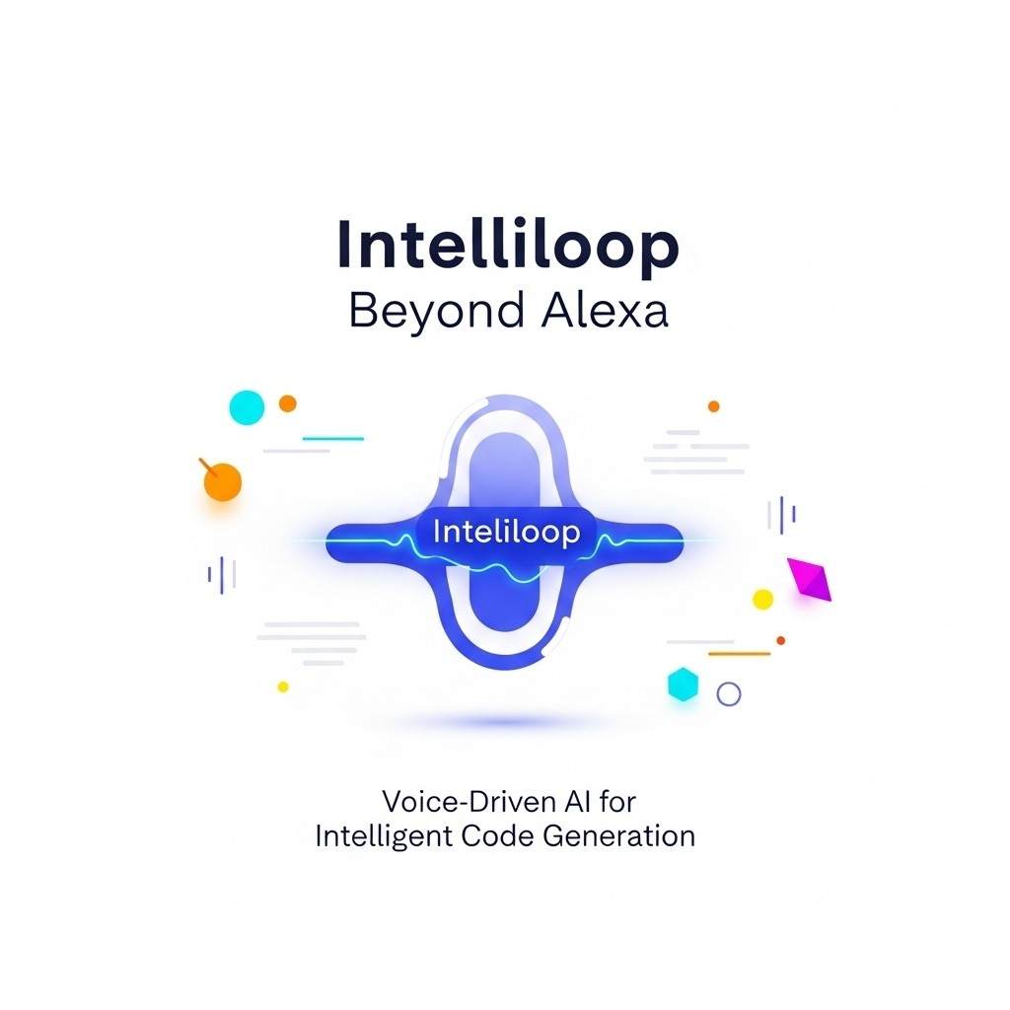
Technology & The Future
AI & Human-Computer Interaction
The Evolution of Voice Assistants into Intelligent Development
From Commands to Code

Slide 3
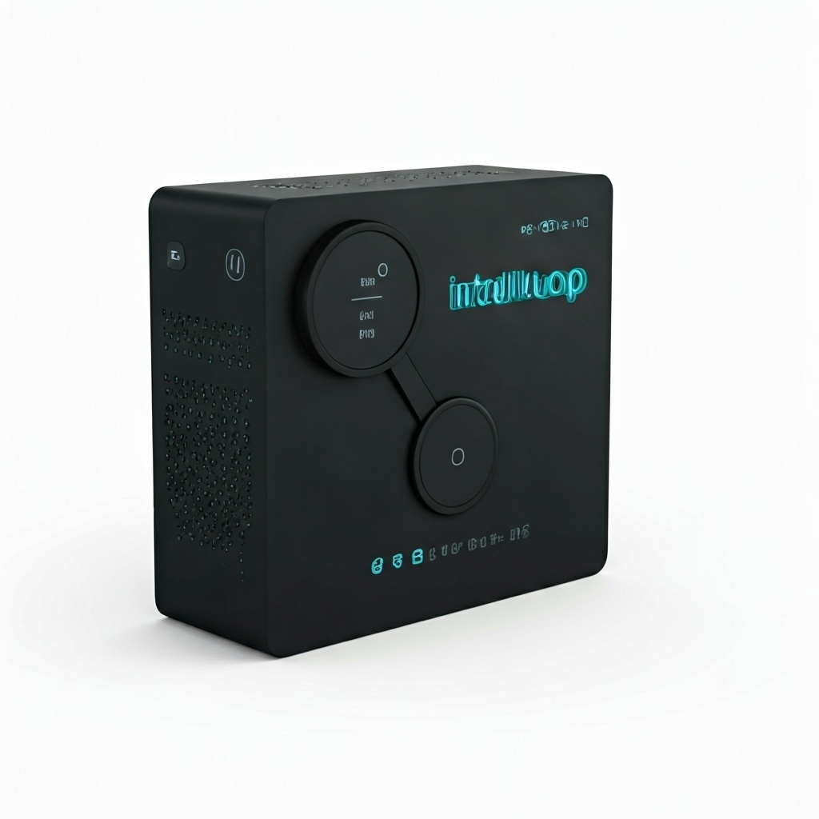
Your Voice, Our Intelligence, Instant Code
Relation
Built on advances in AI voice assistants
Combines speech recognition with AI code generation
Connection
Enables human-AI communication through natural speech
AI translates spoken requests into working code
Makes programming simpler and accessible to more people

Slide 4
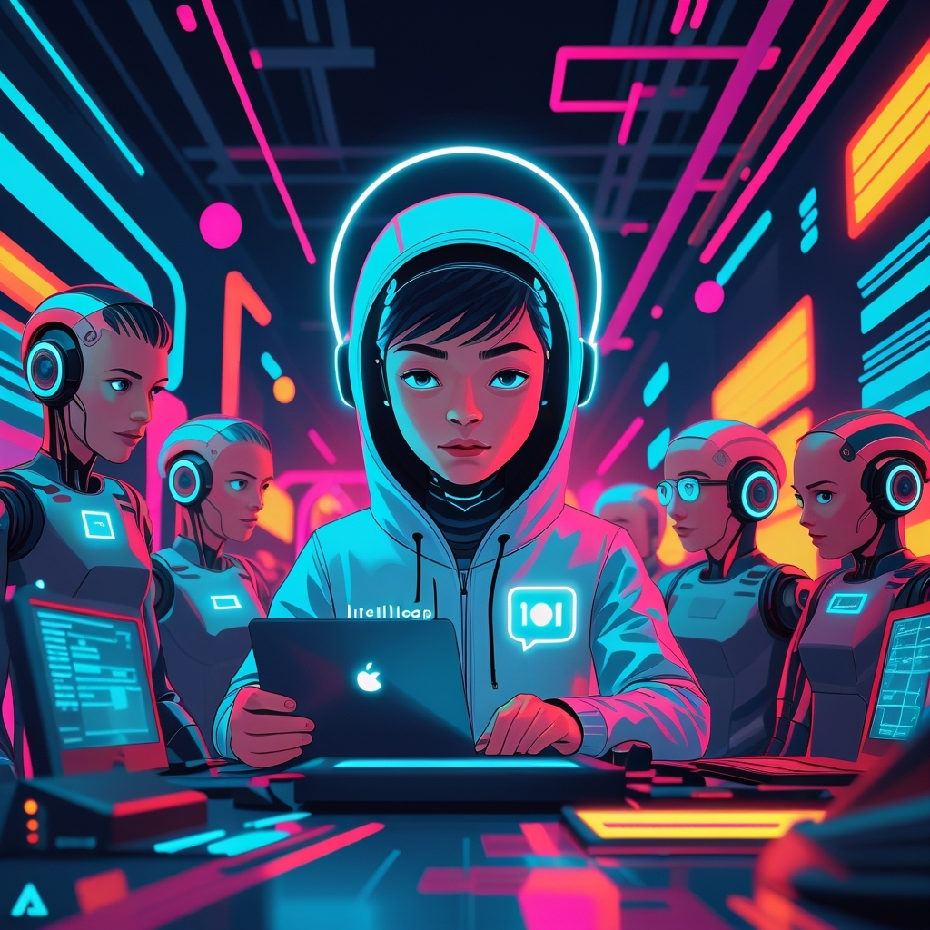
Bridging Imagination and Implementation
Democratizes programming:
Anyone can code by speaking
Boosts productivity
Faster, more efficient development
Bridges digital divide
Empowers non-programmers
Shapes the future of collaboration
Humans guide, AI builds

Slide 5
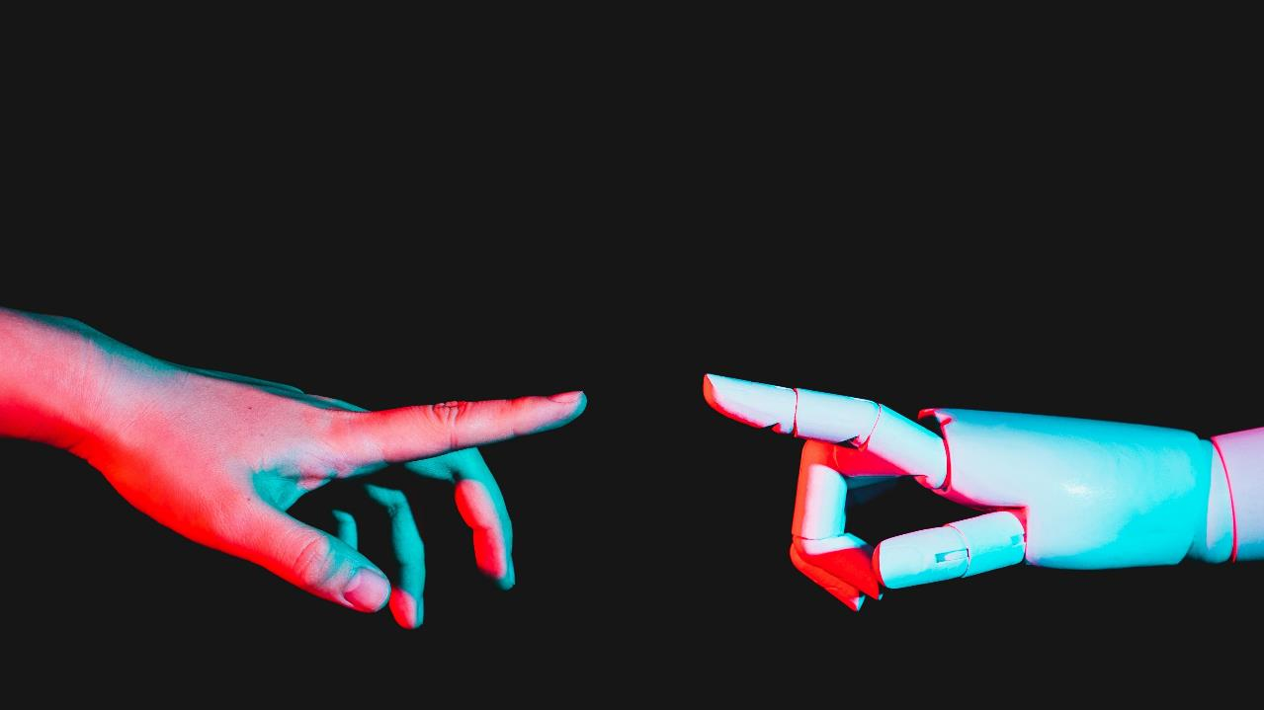
Intelliloop will redefine coding by turning voice into software, making programming accessible to everyone

